Slide 1

Project Title : Krushi Mitra
Team Name : LO-KI DEV
Team Members :
P Sriharsha
P Amaravathi
Safoora Amjad Khan
Hackathon Name : AI HACK DAY

Slide 2


Introduction
Problem Statement:
This project blends machine learning with advanced technology to deliver precise crop selection and soil management insights for Telangana farmers. A web platform provides nutrient predictions, fertilizer analysis, and regional recommendations. Real-time soil analysis and a Telugu chatbot improve accessibility, targeting higher yields and food security.

Slide 3
Project Objective
Integrated Agricultural Solution
Web Platform Features
Real-Time Soil Analysis
Telugu Chatbot Support
Accessibility in Telugu
Bridging Tech & Farming
Scope of the Project:
Regional agricultural data integration
Machine learning-based predictive models
Multi-language support (Telugu)
Web platform accessibility

Slide 4
Unique Concept
AI platform offering personalized Telugu agricultural recommendations
Real-time, context-specific crop strategies
Integration of hyperlocal environmental data
Innovation and Creativity
Inspiration
Supporting small and marginal farmers
Addressing agricultural productivity challenges
Empowering data-driven farming decisions

Slide 5



Nutrient-Based Crop Prediction
Creative Features
Fertilizer Requirement Analysis
District-Specific Recommendations
Telugu Chatbot

Slide 6

Technical Implementation Overview
Technologies Used:
Machine Learning Model
Web Platform
Chatbot
Multilingual Support

Slide 7
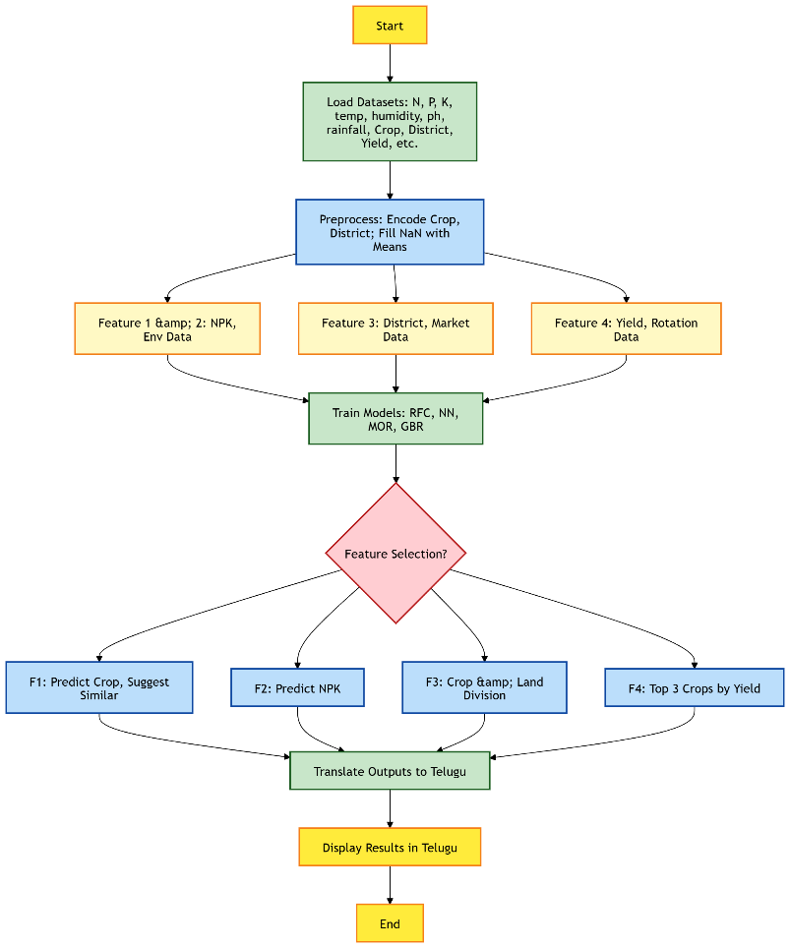
Flow chart
Key Technical Components
Predictive crop recommendation algorithm
Geospatial land strategy mapping
Real-time environmental data integration
Chatbot

Slide 8
Detailed Technical Implementation
Algorithm Overview
Random Forest Classifier: 92% accuracy in crop prediction.
MultiOutput Regressor: Precise NPK recommendations for crops.
Gradient Boosting: High-yield crop ranking and land allocation.
Nearest Neighbors: Suggests similar crops for flexibility
Challenges & Solutions
Limited real-time data → Solution: Robust static datasets.
Telugu translation accuracy → Solution: Googletrans integration.
Model complexity → Solution: Ensemble techniques, tuning.
User adoption → Solution: Simple UI, regional language support.

Slide 9

Data Layer: Static datasets (soil, yield, market) as input.
Architecture Highlights
Processing Layer: ML models analyze and predict outcomes.
Presentation Layer: Flask web app + Telugu chatbot interface.
Translation Layer: Googletrans for bilingual outputs.

Slide 10
Feasibility & Real-World Impact
Real-World Problem Solved:
Eliminates delays in traditional soil analysis.
Addresses poor crop selection and low yields.
Overcomes language barriers for Telangana farmers.
Supports urban farming in space-constrained cities.
Practical Application:
Rural: 92% accurate crop predictions for better planning.
Urban: 80% success in modern cultivation methods.
Reduces decision-making time by 70%.
User/Market Impact:
Boosts farmer productivity and income.
Cuts fertilizer waste, enhancing sustainability.
Expands market reach with urban food production.
Strengthens food security efforts in India.

Slide 11
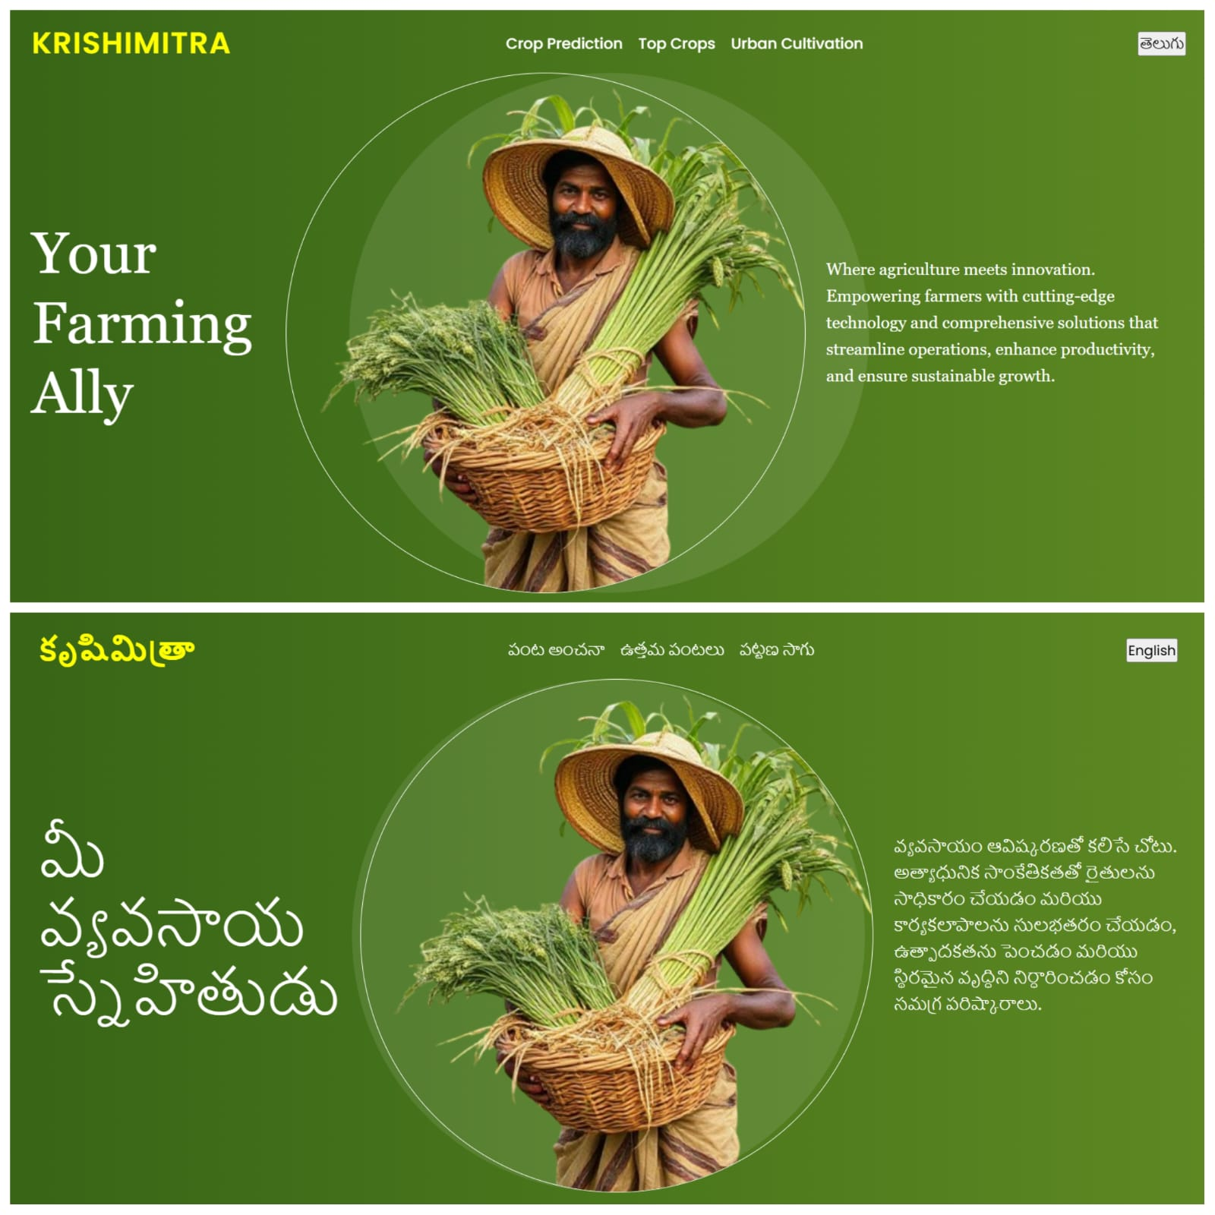
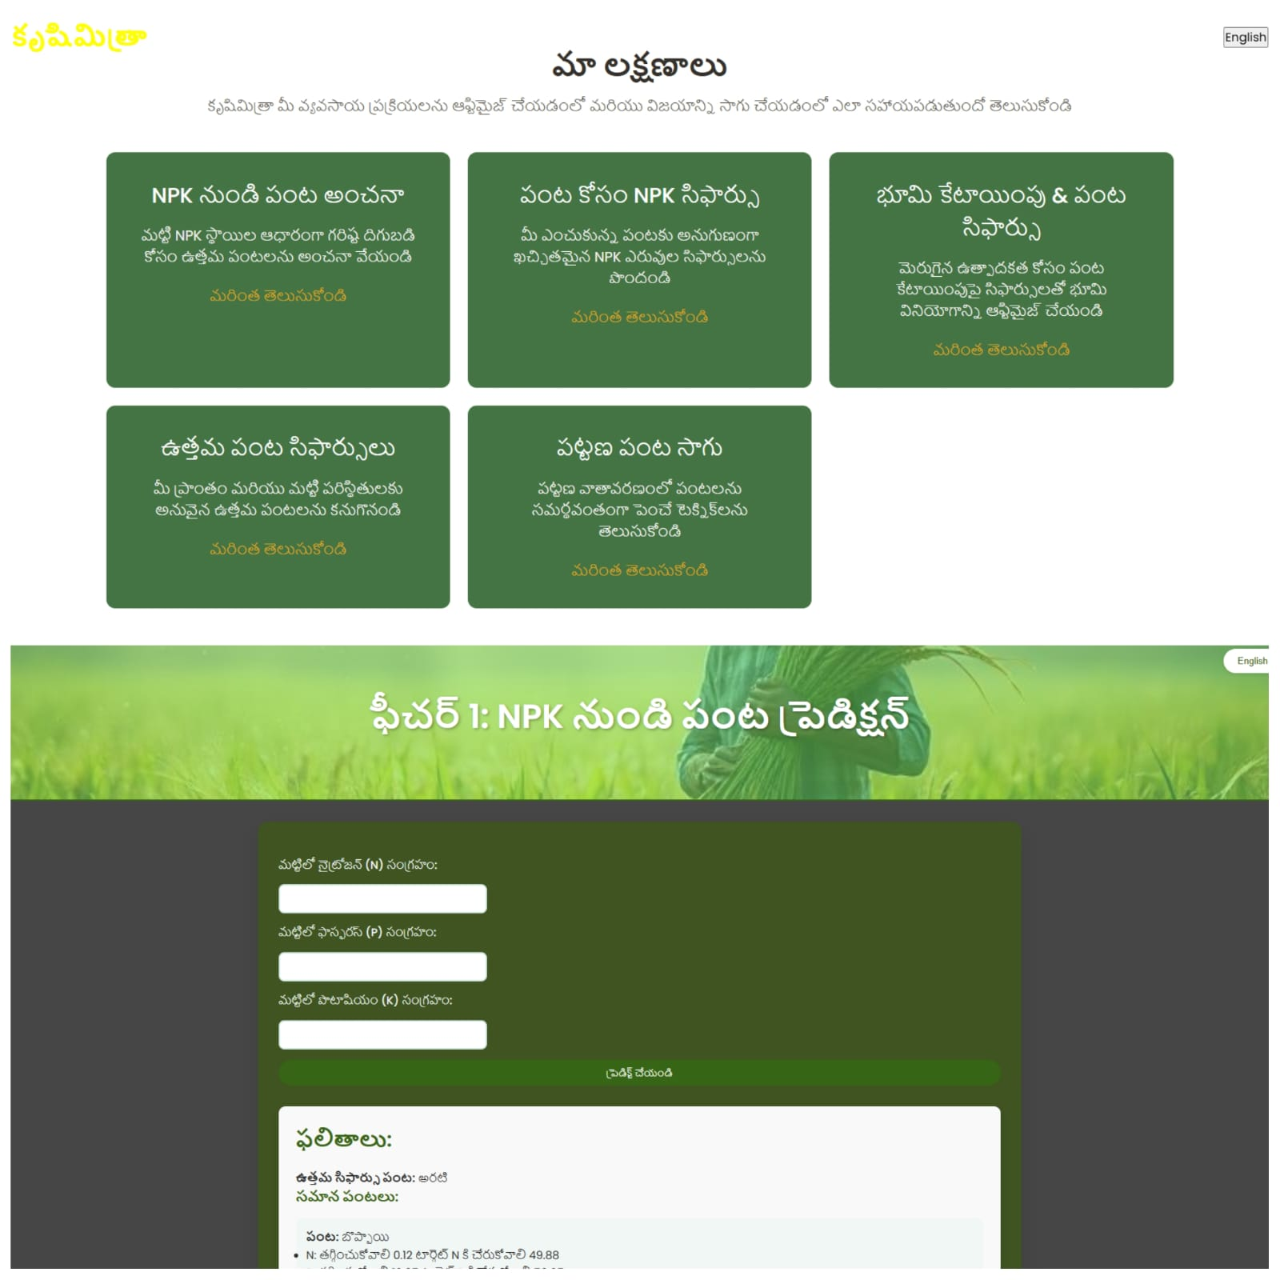
RESULTS:

Slide 12
Future Work & Vision
 | Current Limitations Focuses only on NPK, excludes micro-nutrients. Chatbot lacks deep region-specific pesticide data. No real-time weather or pest integration. Urban setup costs may deter initial adoption.
 | Potential Improvements Include weather forecasts and pest alerts. Expand soil analysis to micro-nutrients. Enhance chatbot with advanced NLP and data. Develop a mobile app for broader access.

Slide 13
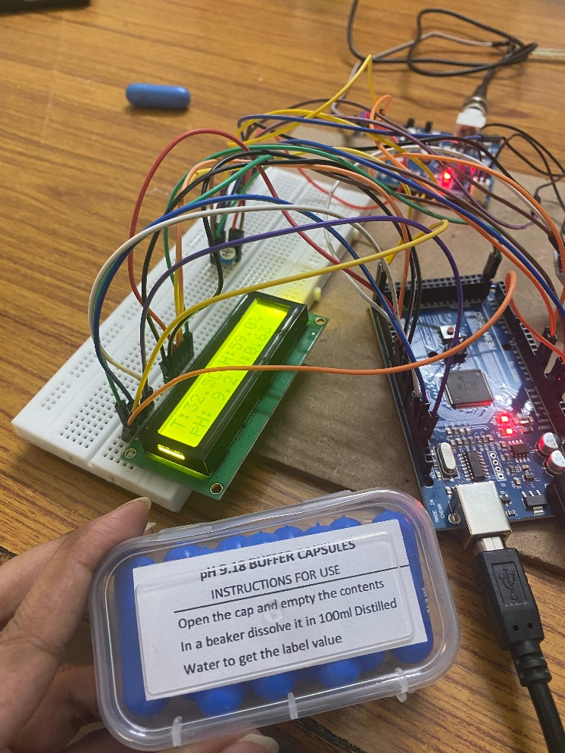
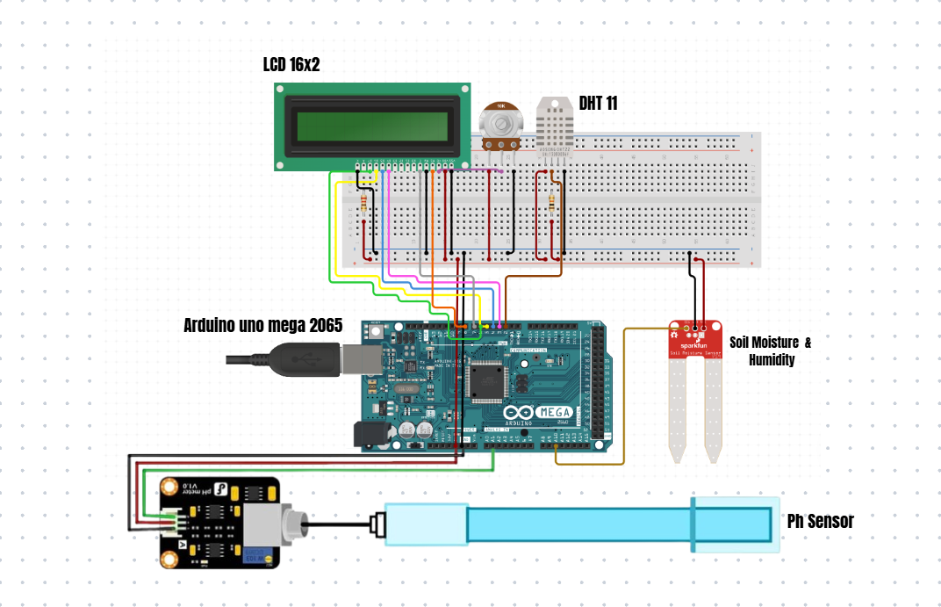
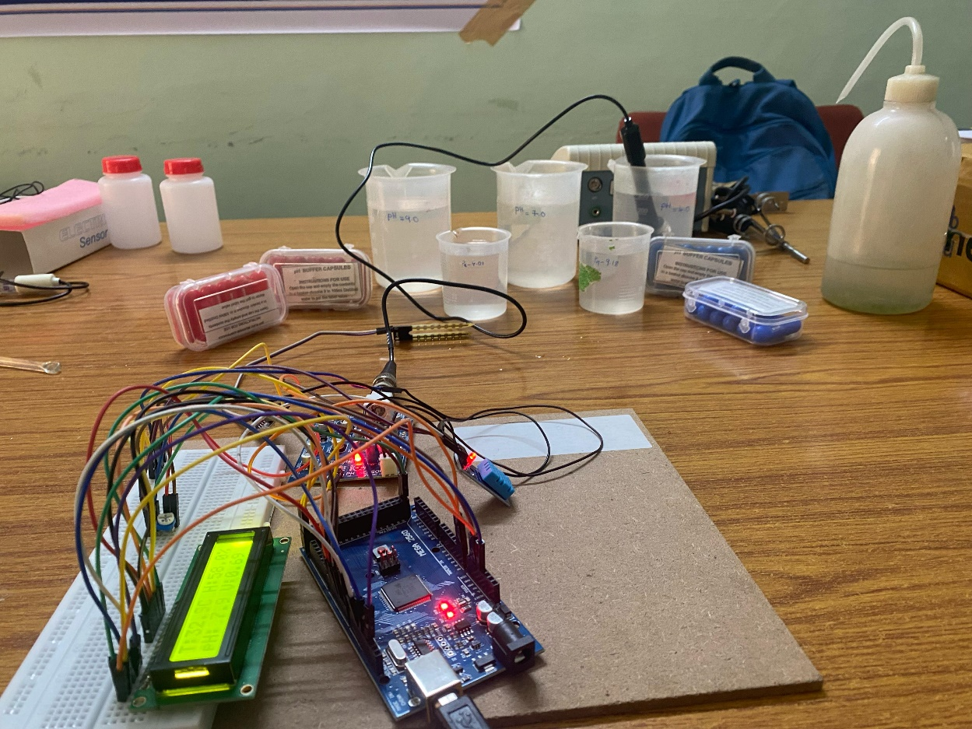
IOT Implementation

